Slide 1
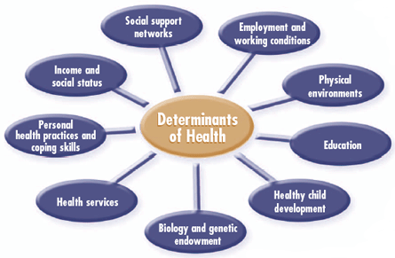
Social Determinants of Health
Bob Marshall, MD MPH MISM Program Director, MAMC/DoD Clinical Informatics Fellowship

Slide 2
Agenda/Objectives
Define Social Determinants of Health
Provide examples
Go into depth on each major category
Discuss how Clinical Informatics interacts with SDH
Discuss the data aspects of SDH and how CI can help health systems identify and address SDH

Slide 3
Definition
Social Determinants of Health (SDH) are linked to the economic and social conditions and their distribution among the population that influence individual and group differences in health status
They are health promoting factors found in one's living and working conditions (such as the distribution of income, wealth, influence, and power) that influence the risk for disease, or vulnerability to disease or injury
They are not individual risk factors (such as behavioral risk factors or genetics)

Slide 4
WHO Perspective
The World Health Organization says, "This unequal distribution of health-damaging experiences is not in any sense a 'natural' phenomenon but is the result of a toxic combination of poor social policies, unfair economic arrangements [where the already well-off and healthy become even richer and the poor who are already more likely to be ill become even poorer], and bad politics

Slide 5
WHO Commission on SDH – 2008 Report
Two broad areas of social determinants of health that needed to be addressed
First area - daily living conditions, which included healthy physical environments, fair employment and decent work, social protection across the lifespan, and access to health care
Second major area - distribution of power, money, and resources, including equity in health programs, public financing of action on the social determinants, economic inequalities, resource depletion, healthy working conditions, gender equity, political empowerment, and a balance of power and prosperity of nations

Slide 6
CDC Definitions
"life-enhancing resources, such as food supply, housing, economic and social relationships, transportation, education, and health care, whose distribution across populations effectively determines length and quality of life"
These include access to care and resources such as food, insurance coverage, income, housing, and transportation
Social determinants of health influence health-promoting behaviors, and health equity among the population is not possible without equitable distribution of social determinants among group

Slide 7
Example of SDH Effects on Health
2005 Report:
Mortality rate of 206.3 per 100,000 for adults aged 25 to 64 years with little education beyond high school
Twice as great (477.6 per 100,000) for those with only a high school education and 3 times as great (650.4 per 100,000) for those less educated

Slide 8
WHO Defined SDH
Social gradient
Stress
Early life
Social exclusion
Work
Unemployment
Addiction
Food
Transportation

Slide 9
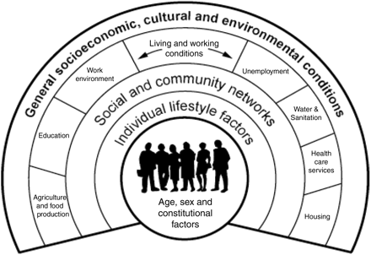

Slide 10
Healthy People 2020 and SDH 1 of 2
Availability of resources to meet daily needs (e.g., safe housing and local food markets)
Access to educational, economic, and job opportunities
Access to health care services
Quality of education and job training
Availability of community-based resources in support of community living and opportunities for recreational and leisure-time activities
Transportation options
Public safety

Slide 11
Healthy People 2020 and SDH 2 of 2
Social support
Social norms and attitudes (e.g., discrimination, racism, and distrust of government)
Exposure to crime, violence, and social disorder (e.g., presence of trash and lack of cooperation in a community)
Socioeconomic conditions {e.g., concentrated poverty and the stressful conditions that accompany it)
Residential segregation
Language/Literacy
Access to mass media and emerging technologies (e.g., cell phones, the Internet, and social media)
Culture

Slide 12
Healthy People 2020 and Physical Determinants
Natural environment, such as green space {e.g., trees and grass) or weather {e.g., climate change)
Built environment, such as buildings, sidewalks, bike lanes, and roads
Worksites, schools, and recreational settings
Housing and community design
Exposure to toxic substances and other physical hazards
Physical barriers, especially for people with disabilities
Aesthetic elements {e.g., good lighting, trees, and benches}

Slide 14
Expanding HP 2020 SDH’s 1 of 3
Economic Stability
Employment
Food Insecurity
Housing Inability
Poverty
Education
Early Childhood Education and Development
Enrolment in Higher Education
High School Graduation
Language and literacy

Slide 15
Expanding HP 2020 SDH’s 2 of 3
Social and Community Context
Civic Participation
Discrimination
Incarceration
Social Cohesion
Health and Health Care
Access to Health Care
Access to Primary Care
Health literacy

Slide 16
Expanding HP 2020 SDH’s 3 of 3
Neighborhood and Built Environment
Access to Foods that Support Healthy Eating Patterns
Crime and Violence
Environmental Conditions
Quality of Housing

Slide 17
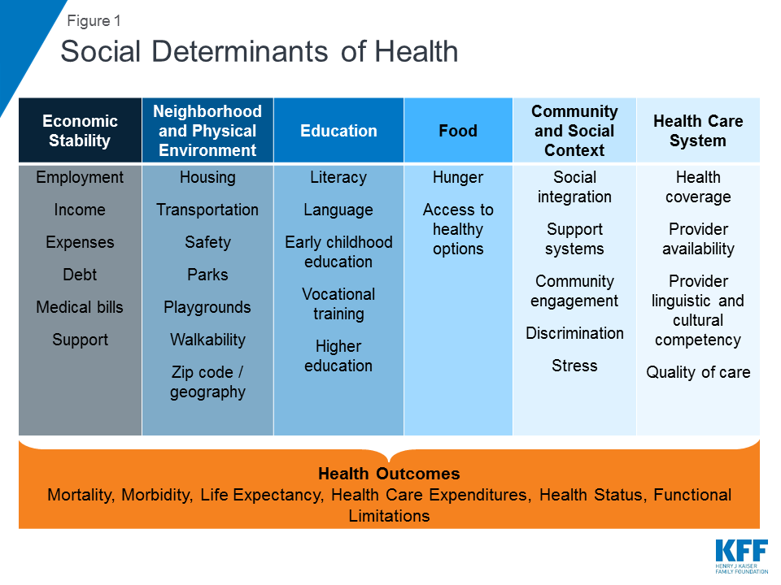

Slide 18
Addressing SDH
Health care is essential to health, but is actually a relatively weak SDH
Health behaviors, like smoking, diet and exercise, are much stronger determinants of premature death
Children born to parents who have not completed high school:
More likely to live in an environment posing barriers to health – lack of safety, exposed garbage and substandard housing
Also less likely to have such things as sidewalks, parks/playgrounds, recreation centers or libraries
Stress negatively affects health across the lifespan
Environmental factors may have multi-generational effects

Slide 19
So What? Why bother with SDH?

Slide 21
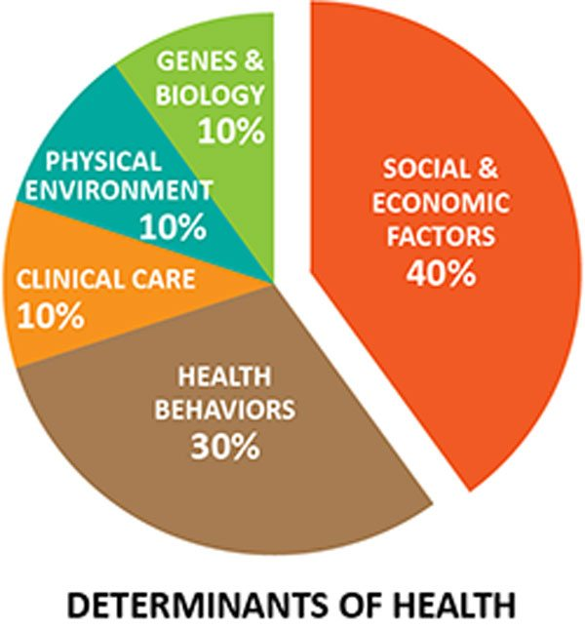

Slide 22
What is the Data & What Does it Show?
A Cochrane review of 21 studies, including 16 randomized controlled trials, found that unconditional cash transfers may not improve health services use
However, they lead to a large, clinically meaningful reduction in the likelihood of being sick by an estimated 27%
Unconditional cash transfers may also improve food security and dietary diversity
Children in recipient families are more likely to attend school, and the cash transfers may increase money spent on health care

Slide 23
Possible Interventions 1 of 2
Education
Increased quantity and quality of education leads to benefits to both the individual and society (e.g. improved labor productivity)
there is currently insufficient evidence to support education as an social determinants intervention with a cost-benefit analysis
Social Protection
Interventions such as “health-related cash transfers”, maternal education, and nutrition-based social protections have been shown to have a positive impact on health outcomes
Full economic costs and impacts generated by social security interventions are difficult to evaluate, especially as many social protections primarily affect children of recipients

Slide 24
Possible Interventions 2 of 2
Urban Development
Urban development interventions include a wide variety of potential targets such as housing, transportation, and infrastructure improvements
Health benefits clearly evident, especially with internal housing improvements (smoke alarm installation, concrete flooring) on children
Affordable housing options (including public housing) can make large contributions to both social determinants of health, as well as the local economy

Slide 25
WHO Commission on SDH
Recommendations in 2005 for action to promote health equity based on three principles:
"improve the circumstances in which people are born, grow, live, work, and age;
tackle the inequitable distribution of power, money, and resources, the structural drivers of conditions of daily life, globally, nationally, and locally; and
measure the problem, evaluate action, and expand the knowledge base."
These recommendations would involve providing resources such as quality education, decent housing, access to affordable health care, access to healthy food, and safe places to exercise for everyone despite gaps in affluence

Slide 26
Where Do We Fit In? 1 of 2
Data about housing, income, education, crime, immunization rates and much more available from any Public Health Department
This data can be used to target areas/populations for intervention
Once an intervention is implemented, one can then watch the various parameters to see about outcomes
If one wants to determine the relative/comparative effectiveness of various interventions on health outcomes, one can either perform logistic regression or compartmentalize interventions (somewhat like a between populations RCT)

Slide 27
Where Do We Fit In? 2 of 2
The data that would come out of this would inform the most effective (and maybe cost-effective) interventions to implement in a period of constrained resources
In terms of deploying health resources, the same data would inform where to locate such things as outpatient clinics, urgent care facilities and pharmacy resources
The data would also inform such things as utilization rates for different health care services…UC, ED, Behavioral Health, Primary Care, Physical Therapy, etc
This allows proper budgeting and resource allocation within the system

Slide 28
Military Translation
DEERS and other demographic data can identify beneficiaries by status (Active Duty/Retired), income, residence location, and more
Public Health data can be combined with the DEERS/demographic data to identify those at greatest risk for health issues
Those identified (including their family members) can be targeted for preventive interventions like education, transportation, child care and other types of support
The intent would be to make those interventions based on perceived need and look at the outcomes for effectiveness

Slide 29
Additional Military Use
When deployed for exercises or for combat, using the same sort of demographic data for the deployment location may help to identify interventions for the local population to assist them but also as a strategic initiative
Civil Affairs can use such information to intercede with humanitarian assistance (exercises) or civil support actions (conflict areas)
Again, outcomes can be measured to look at the effectiveness and general acceptance of various interventions
It is just as important to know what will not work, or be accepted, as what does/is

Slide 30
Summary
Social Determinants of Health are VERY important to the overall well-being of populations
SDH is much more important than delivery of health care in this respect
SDH interventions can occur at the local, regional and national level
Military populations are just as affected by SDH as civilian populations
SDH interventions have the potential to reduce health care costs, positively impact behavioral health issues (including PTSD and domestic violence) and improve in-country relations

Slide 31
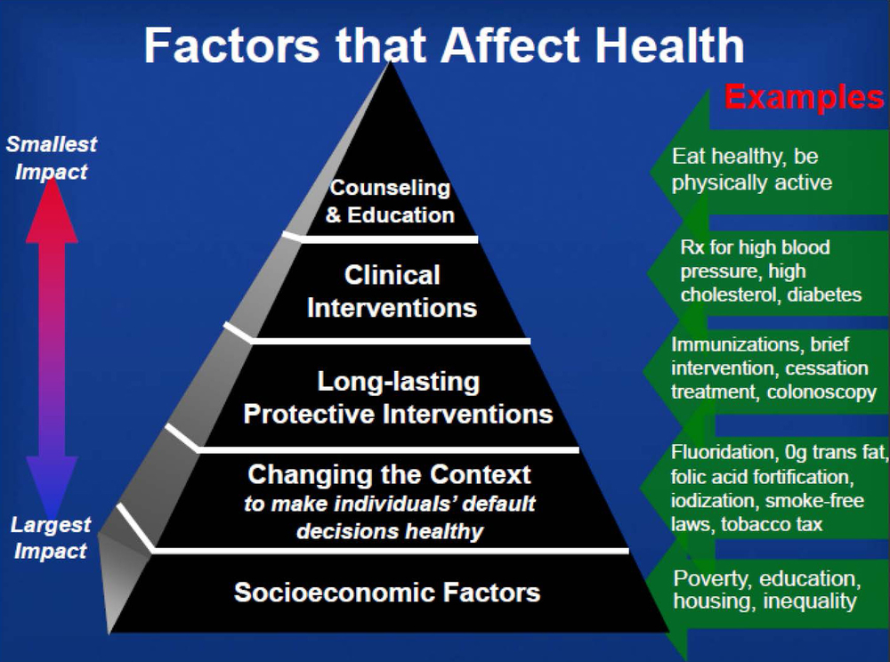
Questions

